Slide 1
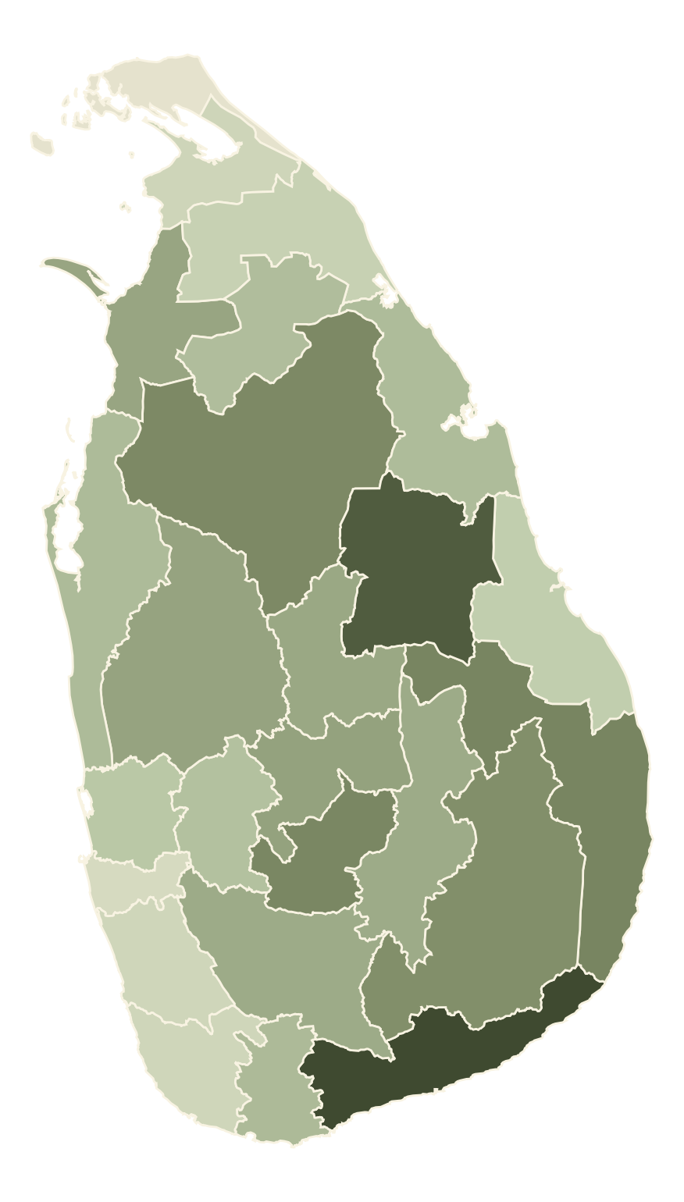
IT 5504 APPLIED MACHINE LEARNING
FINAL ASSIGNMENT | OCTOBER 2026
PADDY
YIELD
PREDICTION
Estimating the yield of every Sri Lankan district at the end of each season with interpretable machine learning
Wijesinghe W K A D U
Index number 269219J · MSc in Artificial Intelligence
Yield by district in the 2025/26 main season

Slide 2
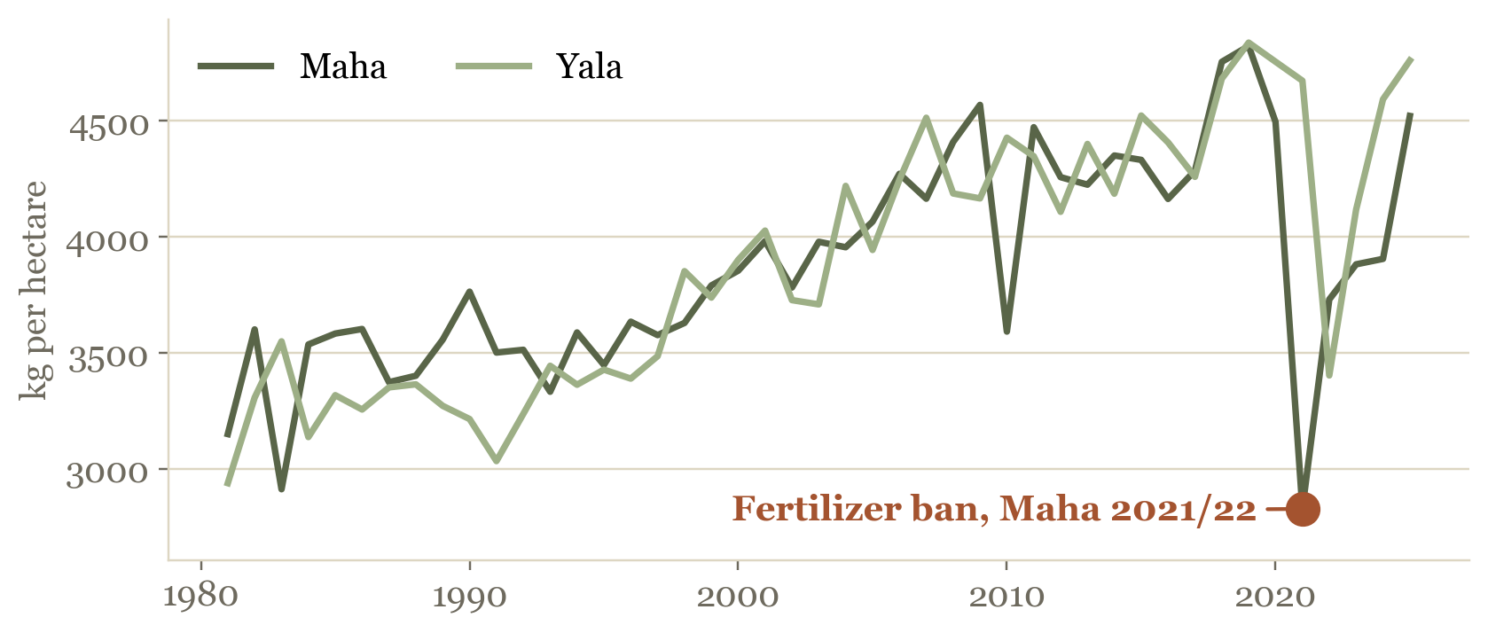
SRI LANKA DISTRICT PADDY YIELD PREDICTION
269219J | OCTOBER 2026
THE PROBLEM
Official district yields arrive months after the harvest, so planning runs without them
Situation
Two seasons a year, Maha (from October) and Yala (from April), in 25 districts and 2 irrigation areas.
NATIONAL YIELD BY SEASON (KG/HA)
Complication
The official yield follows the crop-cutting survey months later, after purchasing, storage and imports are decided.
Objective
Regression of yield (kg/ha) per district and season at season end, judged by mean absolute error (MAE).
2,828
Over 33%
Users
Department of Agriculture, Paddy Marketing Board and policy makers.
kg/ha national Maha yield in 2021/22
fall after the fertilizer ban
02

Slide 3
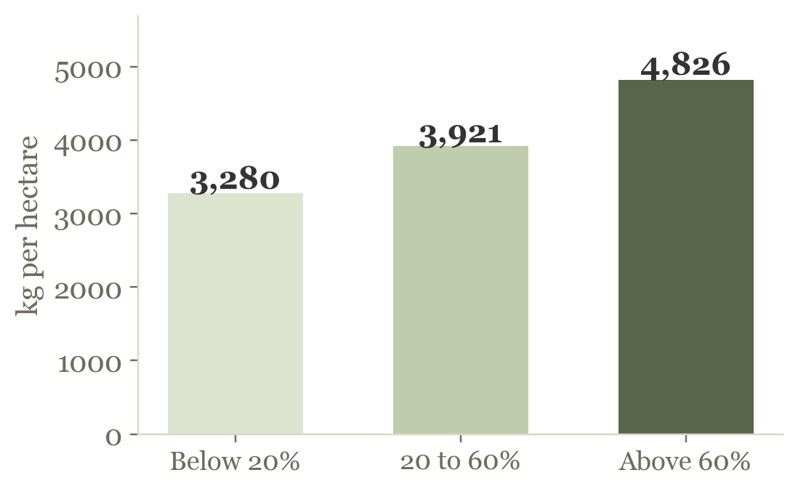
SRI LANKA DISTRICT PADDY YIELD PREDICTION
269219J | OCTOBER 2026
THE DATASET
2,276 district-season records from 1981 to 2026, cleaned and analysed before any modelling
SOURCES USED BY THE FINAL MODEL
MEAN YIELD SINCE 2010 BY MAJOR IRRIGATION SHARE
DCS
8 tables of yield and extent by irrigation type
CHIRPS
daily satellite rainfall per district
NASA POWER
temperature, humidity, solar, wind
OpenStreetMap
district locations and outlines for the weather
Policy record
the 2021/22 ban and 2022 shortage
WHAT THE ANALYSIS SHOWED
Trend
Yields rose from about 3,000 to 4,500 kg/ha over forty years, then fell sharply in 2021/22
CLEANING
34 → 27
21
2
Irrigation
Rainfed share r = -0.61 with yield, far stronger than weather (heavy-rain days r = -0.26)
spellings unified
war-year zeros set to missing
wrong season labels corrected
Seasons
Maha above Yala in 65% of district-years, by 136 kg/ha on average (p < 0.001)
03

Slide 4
SRI LANKA DISTRICT PADDY YIELD PREDICTION
269219J | OCTOBER 2026
DATA PREPROCESSING
Every step was checked on the data, and anything learned from data was fitted on training seasons only
CLEANING, APPLIED ONCE TO THE WHOLE TABLE
PIPELINE, FITTED ON THE TRAINING SEASONS OF EACH FOLD
Null detection
6,130 dash cells and NASA -999 codes turned into missing values (4.5, 6.1)
Missing values
Missing yields left out. Missing inputs filled with the training median, 3,372 gaps (6.1, 9.3)
Inconsistent data
34 spellings to 27 places, 2000/2021 and 198 labels fixed, tables cross-checked (4.3, 4.4, 6.3)
Multicollinearity
Correlation and variance inflation factor (VIF) checked, one temperature kept of three (7.3, 10.1)
Outliers
21 war-year zero yields set to missing, genuine extremes kept, interquartile range (IQR) and local checks (6.4)
Transformation
Log of five skewed features tested, no gain (358 against 355), so not used (9.3)
Duplicates and types
No duplicate district-seasons, every column converted to its proper type (6.2, 6.5)
Scaling
StandardScaler kept, RobustScaler gave the same error (355.0 and 355.2) (9.3)
Leakage
Production and harvested extent excluded, history from earlier seasons only (7.4, 9.4)
Encoding
One-hot district and season. Models with native category support skip this step (9.3, 15.5)
04

Slide 5
SRI LANKA DISTRICT PADDY YIELD PREDICTION
269219J | OCTOBER 2026
FEATURE SELECTION
23 features were selected, plus a fertilizer shortage switch for scenarios
5
5
7
4
3
TESTED, NOT KEPT
YIELD HISTORY
PLANTING
RAINFALL
WEATHER
PLACE, POLICY
Fertilizer imports
Neighbouring districts
Greenness (NDVI)
El Niño, IOD
Rice crop health
Soil moisture
Subsidy level
Heat at flowering
3-season average
Same season last year
Previous season
National previous season
ARIMA forecast
Sown extent
Sown vs last 3 seasons
Major irrigation share
Minor irrigation share
Rainfed share
Season rainfall
Rainfall vs normal
Wettest month
Driest month
Rain before season
Longest dry spell
Heavy-rain days
Max temperature
Humidity
Solar radiation
Wind
District
Season
Fertilizer shortage
A new source was kept only if it lowered the mean validation MAE of three reference models, Ridge regression, XGBoost and CatBoost, by over 1%. Clean-ups only had to not raise it.
05

Slide 6
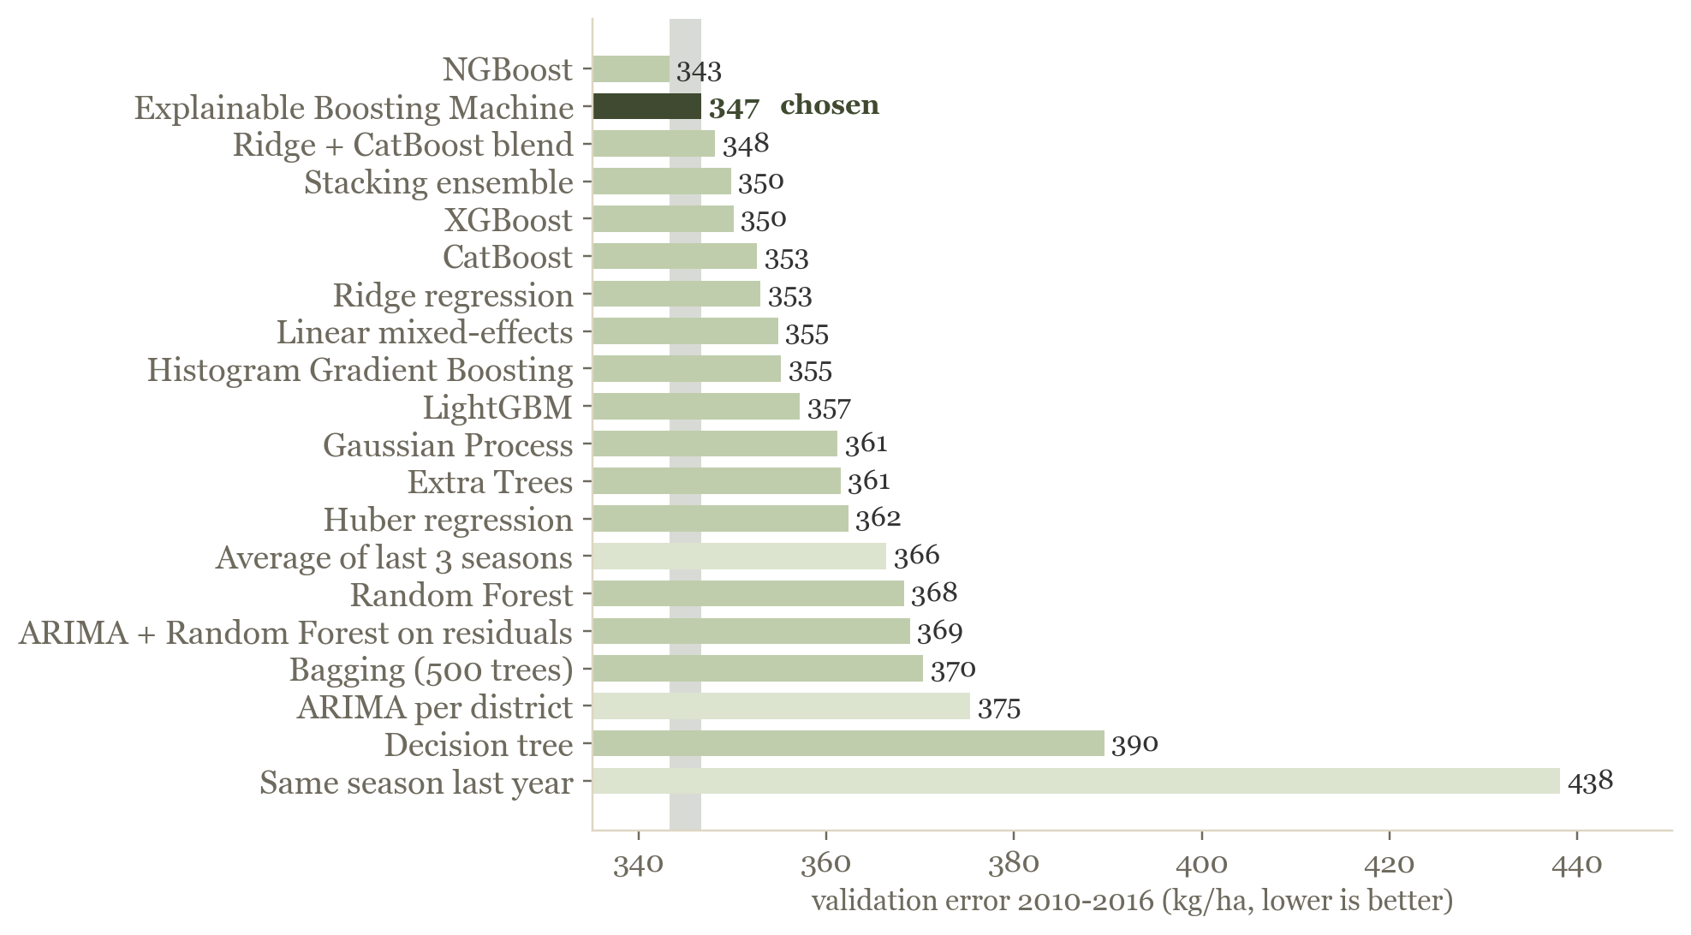
SRI LANKA DISTRICT PADDY YIELD PREDICTION
269219J | OCTOBER 2026
MODEL SELECTION
The Explainable Boosting Machine (EBM) was selected from 20 models on validation years only
MEAN ABSOLUTE ERROR OVER SEVEN VALIDATION YEARS (KG/HA)
Time split
Expanding folds validate 2010-2016, final fit 1981-2016, test 2017-2026 once
Designed settings
XGBoost rate 0.03, depth 3, L2 5. CatBoost depth 4, L2 10. Random Forest 500 trees, depth 8, leaf 10. EBM 5 interactions, 8 bags (12.3)
Tuning
Early stopping at 359, 248 and 736 rounds. Grid search gained only 3 to 6 kg/ha against a fold spread of 84 to 90, so the designed values were kept
Tie rule
Within 1% of the best MAE is a tie, NGBoost 343 and EBM 347
Stability
Lower fold-to-fold deviation wins, 79 against 90. Confirmed on test, EBM 446 and NGBoost 459
No leakage
Nine leakage checks passed in code, the refitted ARIMA forecast reproduces the stored 4,945.0
06

Slide 7
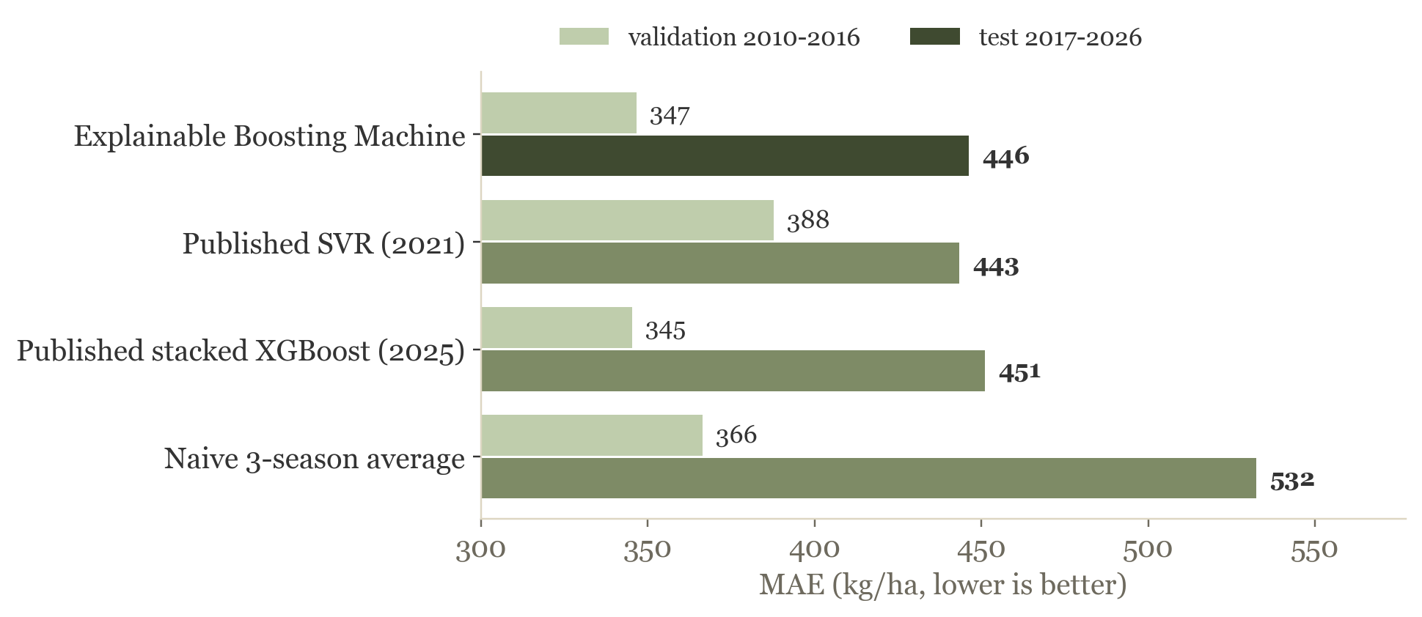
SRI LANKA DISTRICT PADDY YIELD PREDICTION
269219J | OCTOBER 2026
RESULTS AND EVALUATION
87.6% accuracy on 18 unseen seasons, level with the best models and better than the naive baseline
87.6%
446
0.58
86%
accuracy, 100% minus the mean absolute percentage error (MAPE) of 12.4%
kg/ha test MAE, 532 for the 3-season average
R², 0.72 outside the two ban seasons
of estimates within 20% of the official yield
FURTHER ERROR MEASURES, TEST 2017-2026
BENCHMARK, PUBLISHED METHODS REBUILT ON THE SAME DATA
Training / validation / test MAE
235 / 347 / 446 kg/ha
Median absolute error
328 kg/ha, naive average 405
Bias (estimate minus actual)
-16 kg/ha
Skill vs 3-season average
16% less error
The EBM (446) matches the published support vector regression (SVR, 443) and stacked XGBoost (451). Among the 20 candidates the Gaussian Process (426), Ridge and Huber (both 438) were best on test but not chosen, as choosing on test would bias the score. EBM vs Ridge p = 0.61, vs naive p = 0.025 (Diebold-Mariano).
07

Slide 8
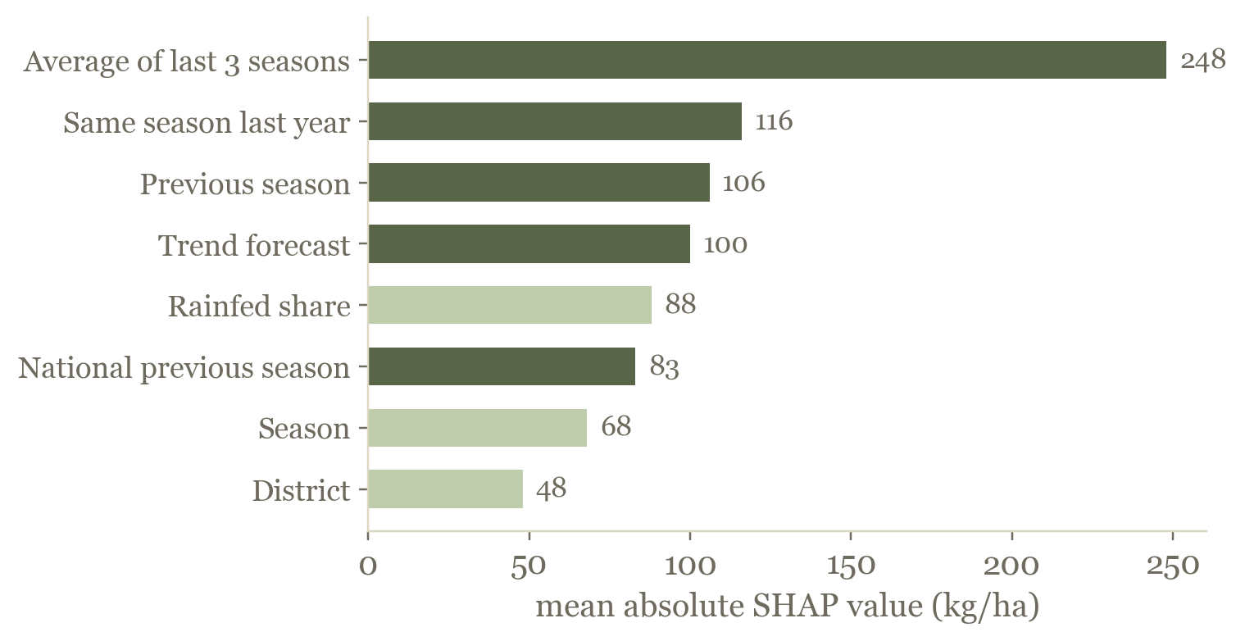
SRI LANKA DISTRICT PADDY YIELD PREDICTION
269219J | OCTOBER 2026
INTERPRETATION AND CONCLUSION
Recent yields and irrigation drive the estimates, and a shock absent from the inputs cannot be anticipated
SHAP, MEAN ABSOLUTE CONTRIBUTION ON THE TEST SEASONS (KG/HA)
STRENGTHS
— 87.6% accurate across 18 unseen seasons
— National production within 5.8% on average outside the crisis
— 80% conformal range ± 545 kg/ha, 72% coverage on test
LIMITATIONS
— Missed the 2021/22 crash by about 1,500 kg/ha
— Northern districts least accurate, 14 to 24% error
SHAP (17.1), with LIME (17.3) and the EBM's own curves agreeing. The 3-season average contributes 248 kg/ha, twice the next feature. These are attributions of the model, not causal effects.
NEXT STEPS
— District fertilizer distribution data
— Seasonal drift monitoring, already automated
08

Slide 9



SRI LANKA DISTRICT PADDY YIELD PREDICTION
WIJESINGHE W K A D U | 269219J
THANK YOU
Deployed on Azure Container Apps, tested on every push with GitHub Actions and checked for drift every six hours
Web application
Prediction API
Source code
paddy-yield-app.grayflower-d27356cf.malaysiawest.azurecontainerapps.io
paddy-yield-api.grayflower-d27356cf.malaysiawest.azurecontainerapps.io/docs
github.com/Uthpalagit/paddy-yield-prediction-269219J
Backup copy on Streamlit Community Cloud paddy-yield-prediction-269219j-2wfd9iajbb7ebf2jpuzzgb.streamlit.app
Slide design adapted from the SlidesCarnival template Minimalist Marketing Annual Report, CC BY 4.0
09

